Slide 1

DSO 530 Final Project
Zhuoqun SHENG
He YOU

Slide 2
Background, Observations, and Procedures
Assumptions and Variables
Analysis into IMDb Score
Analysis into Gross
Conclusions and Recommendations

Slide 3
Background, Observations, and Procedures
IMDb data for 5000 movies was exported from Kaggle.com
2589 unique, post-2000 U.S. movie titles were analyzed
The goal is to analyze the relationship between gross and IMDb score and the other variables.
.

Slide 4
Assumptions & Variables
Assumptions
Gross reflects popularity in movie market
IMDb score reflects
Dependent variables: IMDB score (numerical) and, subsequently, gross (numerical)
A categorical dependent variable was created using IMDB score – if IMDB_score >= 7, value = 1, otherwise value = 0.
The threshold of 7 was selected because group members would be more likely to watch a movie if it had a score of 7+.
Independent variables: budget (numerical), duration (numerical), movie Facebook likes (numerical), actor 1-3 Facebook likes (numerical), cast Facebook likes (numerical), Director Facebook likes (numerical), number of critics (numerical), number of voters (numerical), genre (categorical), plot keywords (categorical), title year (numerical), actor 1-3 (categorical), director (categorical)

Slide 5
Analysis into IMDb Score
.
.

Slide 6
Analysis into IMDb Score
Genres
Notes:
We assume that gross has relationship with both production and marketing process, thus gross is probably affected by factors including budget, duration and popularity of director and cast (which is reflected by Facebook likes). Additionally, gross is also affected by word-of-mouth marketing online, which could be reflected through IMDb score, number of voted users and number of critics for reviews.

Slide 7
Analysis into IMDb Score
Keywords
Notes:
We assume that gross has relationship with both production and marketing process, thus gross is probably affected by factors including budget, duration and popularity of director and cast (which is reflected by Facebook likes). Additionally, gross is also affected by word-of-mouth marketing online, which could be reflected through IMDb score, number of voted users and number of critics for reviews.

Slide 8
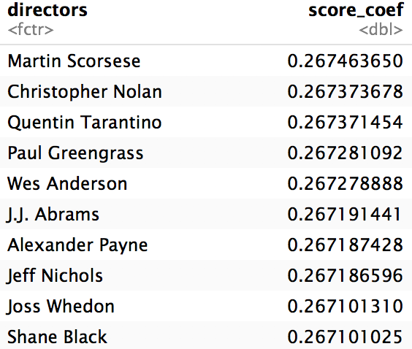
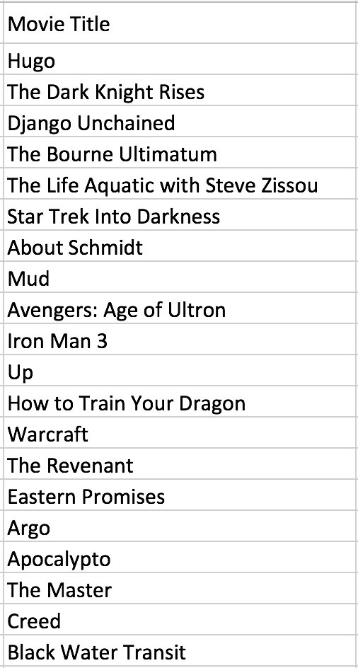
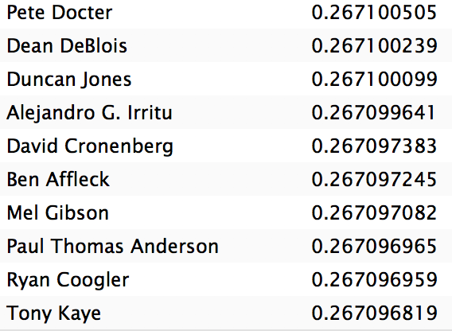
Analysis into IMDb Score
Directors – Highest Score
Notes:
We assume that gross has relationship with both production and marketing process, thus gross is probably affected by factors including budget, duration and popularity of director and cast (which is reflected by Facebook likes). Additionally, gross is also affected by word-of-mouth marketing online, which could be reflected through IMDb score, number of voted users and number of critics for reviews.

Slide 9
Analysis into IMDb Score
Directors – Lowest Score
Notes:
We assume that gross has relationship with both production and marketing process, thus gross is probably affected by factors including budget, duration and popularity of director and cast (which is reflected by Facebook likes). Additionally, gross is also affected by word-of-mouth marketing online, which could be reflected through IMDb score, number of voted users and number of critics for reviews.

Slide 10
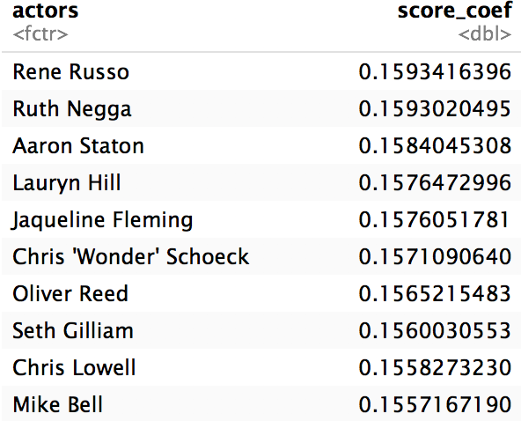
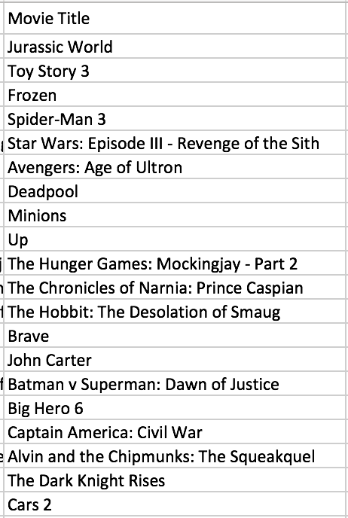
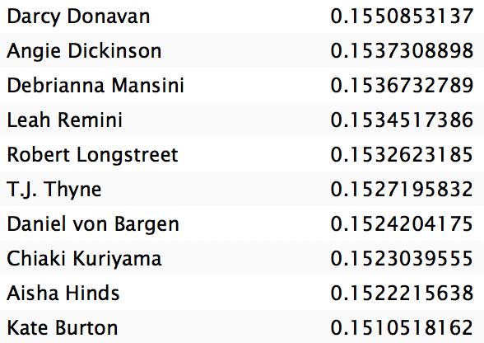
Analysis into IMDb Score
Actors – Highest Score
Notes:
We assume that gross has relationship with both production and marketing process, thus gross is probably affected by factors including budget, duration and popularity of director and cast (which is reflected by Facebook likes). Additionally, gross is also affected by word-of-mouth marketing online, which could be reflected through IMDb score, number of voted users and number of critics for reviews.

Slide 11
Analysis into IMDb Score
Actors – Lowest Score
Notes:
We assume that gross has relationship with both production and marketing process, thus gross is probably affected by factors including budget, duration and popularity of director and cast (which is reflected by Facebook likes). Additionally, gross is also affected by word-of-mouth marketing online, which could be reflected through IMDb score, number of voted users and number of critics for reviews.

Slide 12
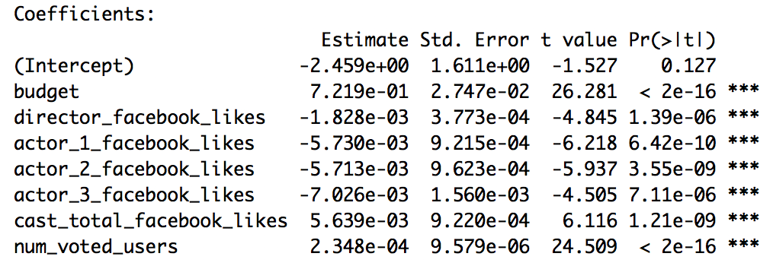
Analysis into Gross
Linear Regression Analysis
Variables:
budget, duration, title year, director Facebook likes, imdb score, actor 1 Facebook likes, actor 2 Facebook likes, actor 3 Facebook likes, cast total Facebook likes, movie Facebook likes, number of voted users, number of critic for reviews, face number in poster.
Notes:
We assume that gross has relationship with both production and marketing process, thus gross is probably affected by factors including budget, duration and popularity of director and cast (which is reflected by Facebook likes). Additionally, gross is also affected by word-of-mouth marketing online, which could be reflected through IMDb score, number of voted users and number of critics for reviews.

Slide 13
Analysis into Gross
Ridge Model and Lasso Model Analysis
Variables:
Genres, Keywords, Directors, Actors
Notes:
We assume that gross has relationship with both production and marketing process, thus gross is probably affected by factors including budget, duration and popularity of director and cast (which is reflected by Facebook likes). Additionally, gross is also affected by word-of-mouth marketing online, which could be reflected through IMDb score, number of voted users and number of critics for reviews.

Slide 14
Analysis into Gross
Genres
Notes:
We assume that gross has relationship with both production and marketing process, thus gross is probably affected by factors including budget, duration and popularity of director and cast (which is reflected by Facebook likes). Additionally, gross is also affected by word-of-mouth marketing online, which could be reflected through IMDb score, number of voted users and number of critics for reviews.

Slide 15
Analysis into Gross
Keywords
Notes:
We assume that gross has relationship with both production and marketing process, thus gross is probably affected by factors including budget, duration and popularity of director and cast (which is reflected by Facebook likes). Additionally, gross is also affected by word-of-mouth marketing online, which could be reflected through IMDb score, number of voted users and number of critics for reviews.

Slide 16
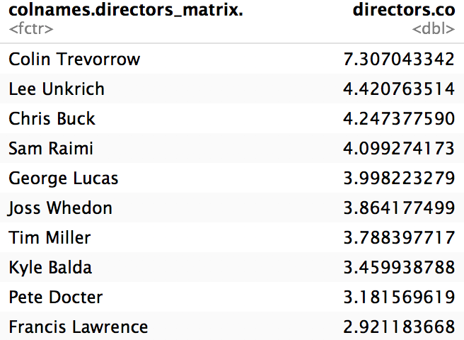

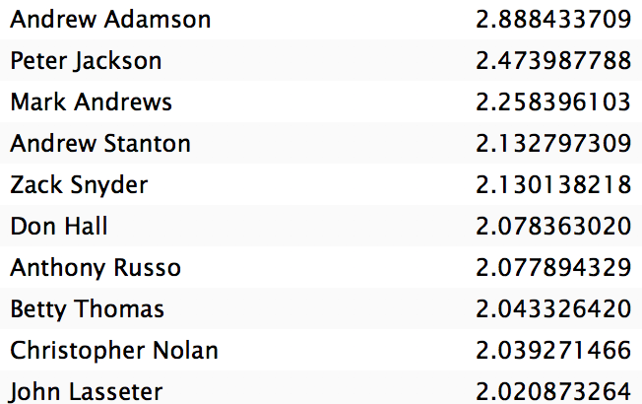
Analysis into Gross
Directors – Highest Gross
Notes:
We assume that gross has relationship with both production and marketing process, thus gross is probably affected by factors including budget, duration and popularity of director and cast (which is reflected by Facebook likes). Additionally, gross is also affected by word-of-mouth marketing online, which could be reflected through IMDb score, number of voted users and number of critics for reviews.

Slide 17
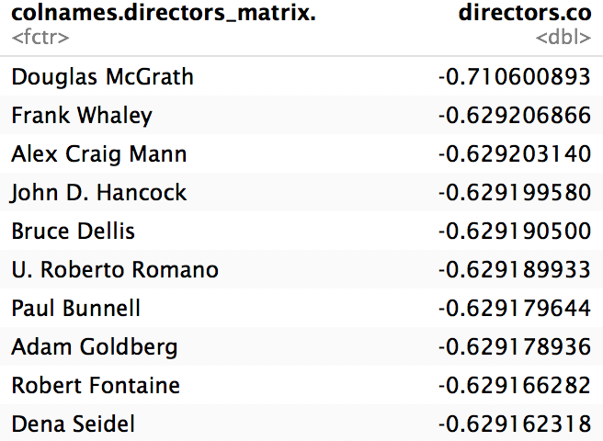
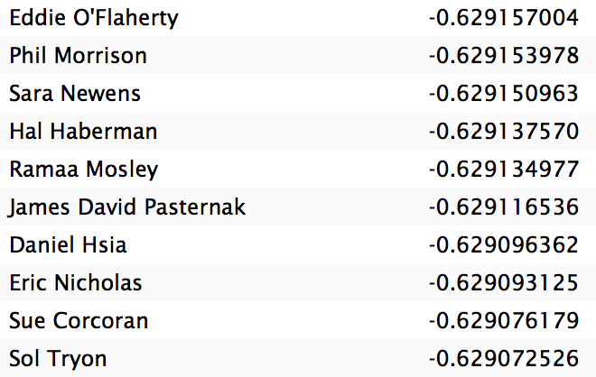
Analysis into Gross
Directors – Lower Gross
Notes:
We assume that gross has relationship with both production and marketing process, thus gross is probably affected by factors including budget, duration and popularity of director and cast (which is reflected by Facebook likes). Additionally, gross is also affected by word-of-mouth marketing online, which could be reflected through IMDb score, number of voted users and number of critics for reviews.

Slide 18
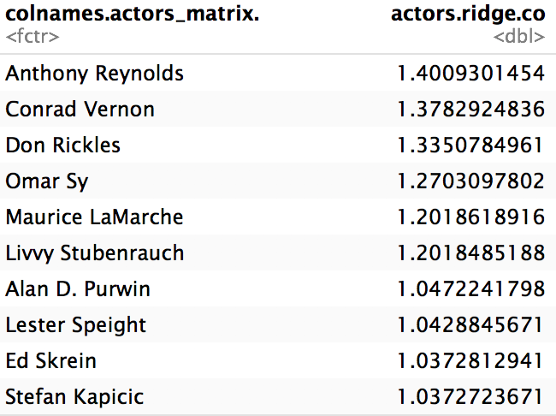
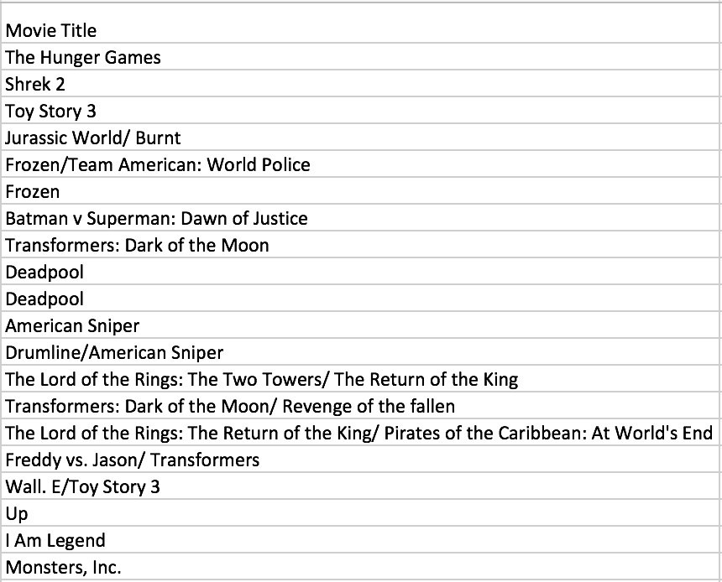
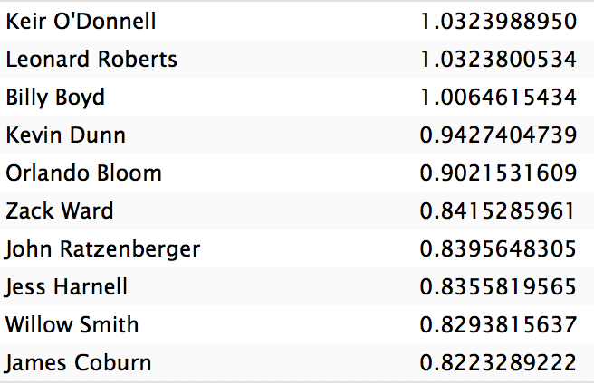
Analysis into Gross
Actors – Highest Gross
Notes:
We assume that gross has relationship with both production and marketing process, thus gross is probably affected by factors including budget, duration and popularity of director and cast (which is reflected by Facebook likes). Additionally, gross is also affected by word-of-mouth marketing online, which could be reflected through IMDb score, number of voted users and number of critics for reviews.

Slide 19
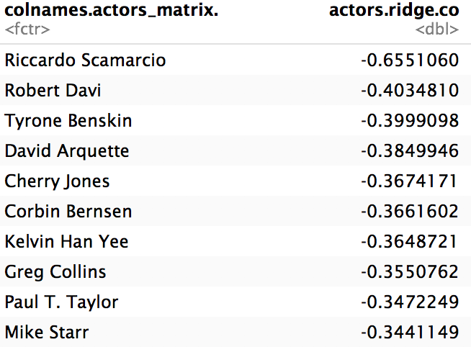
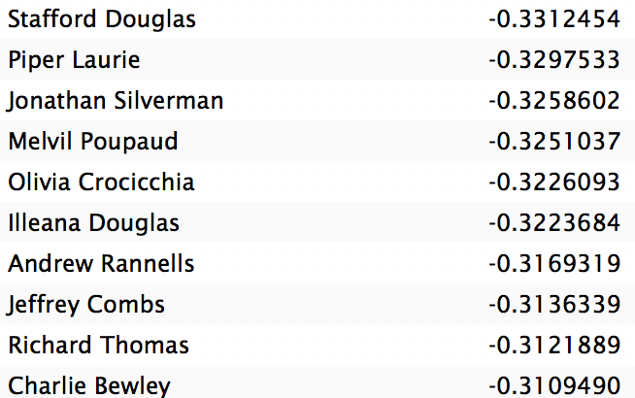
Analysis into Gross
Actors – Lowest Gross
Notes:
We assume that gross has relationship with both production and marketing process, thus gross is probably affected by factors including budget, duration and popularity of director and cast (which is reflected by Facebook likes). Additionally, gross is also affected by word-of-mouth marketing online, which could be reflected through IMDb score, number of voted users and number of critics for reviews.

Slide 20
Analysis into Gross
Linear Regression Analysis
Variables:
budget, duration, title_year, director_facebook_likes, imdb_score, actor_1_facebook_likes, actor_2_facebook_likes,actor_3_facebook_likes, cast_total_facebook_likes, movie_facebook_likes, num_voted_users, num_critic_for_reviews, facenumber_in_poster
Notes:
We assume that gross has relationship with both production and marketing process, thus gross is probably affected by factors including budget, duration and popularity of director and cast (which is reflected by Facebook likes). Additionally, gross is also affected by word-of-mouth marketing online, which could be reflected through IMDb score, number of voted users and number of critics for reviews.

Slide 21
Conclusions

Slide 22
Recommendations
.

Slide 23
Resources
Data from Kaggle
PowerPoint background from MyFreePPT.com

